Slide 1
KEY FEATURES OF ESTONIAN EDUCATION
Heli Mattisen
Skövde, 17.01.2019

Slide 2
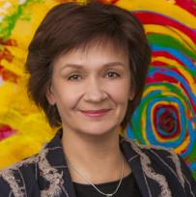
Tere!
I am Heli Mattisen
Director
Estonian Quality Agency for Higher and Vocational Education
Notes:
Working at the agency assesseing the quality of higher and vocational education, but focusing today mainly on general education, as it is forms the foundation.
I have worked for the main teacher education university for 20 years, have been in charge of teacher education strategies in Estonia and praticipated in development of Estonian LLL strategy 2020

Slide 3

Estonia in numbers
100 years of the Republic of Estonia
Population 1,3 million
30 people per km²
2 out of 3 people live in towns
Unemployment rate 5,1%
Average monthly salary 1354 EUR
Literacy rate 98,5%
More start-up companies per capita than any other country in Europe
Basic education the best in Europe and in the top 3 globally

Slide 4
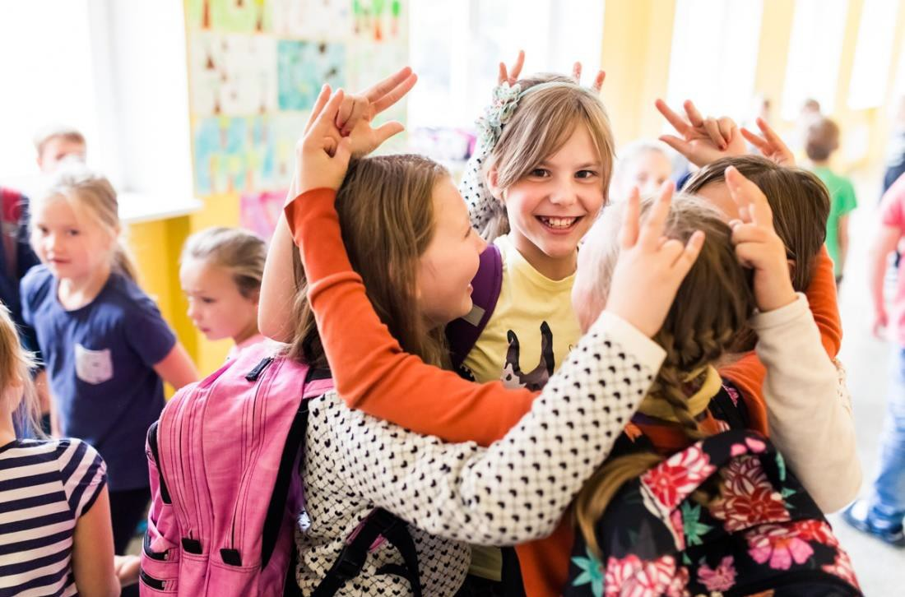
PISA 2015 Estonia
Position Europe/World:
Science 1/3
Math 1-2/9
Reading 3/6
Equity:
Impact of socio-economical and cultural background 8%
Resiliant students 48%
Low performers 12%
Top performers:
Science 13,5%
Reading 11,1%
Math 14,2%

Slide 5
In PISA rankings
ESTONIA
FINLAND
YEAR | SCIENCE | READING | MATH
2006 | 2 | 6 | 6
2009 | 2 | 5 | 6
2012 | 2 | 4 | 3
2015 | 1 | 3 | 2
YEAR | SCIENCE | READING | MATH
2006 | 1 | 1 | 1
2009 | 1 | 1 | 1
2012 | 1 | 1 | 4
2015 | 2 | 1 | 5
The position of Estonia and Finland in PISA rankings among European countries
Notes:
We always compare ourselves with Finland. We have learned a lot from our neighbors. Whae we look at the table one could imagine that Estonian people are celebrating the results also compared to Finnland, but – we are worried about our results in reading instead - oranžiga värvib Readingu üle. Anyway, let’s try to find out what are the feasible success factors of Estonian basic education. It is quite a long list of possible success factors, and most of the are common fo tyhe majority of European countries, including Sweden.

Slide 6
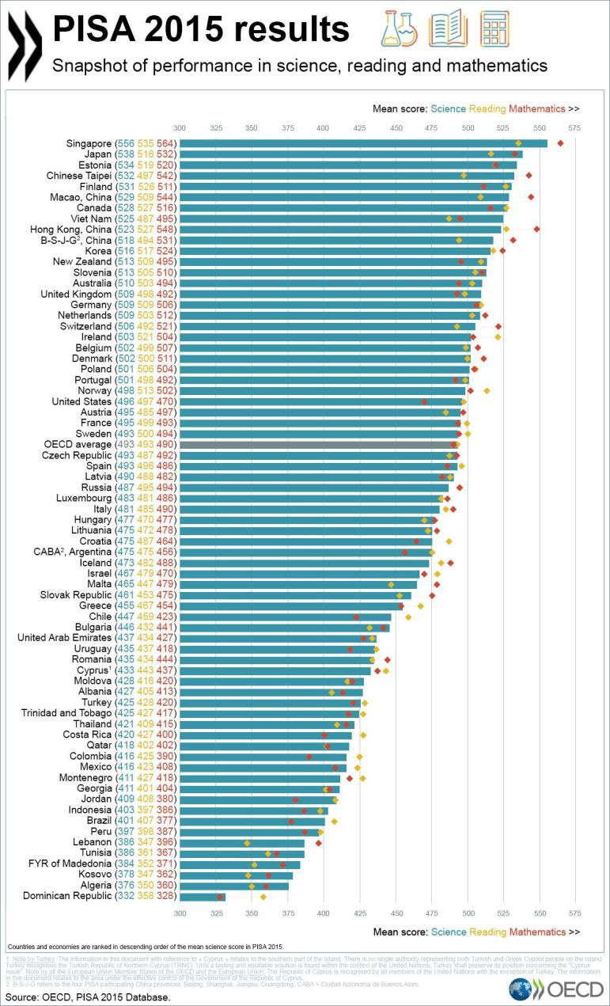
Quality
„If we can't be a great nation in population we can be a great nation in spirit!“
Jakob Hurt (1839-1907) Estonian folklorist and linguist, one of the most important figures
of Estonian national
awakening.
Equality
„The best way to reduce social inequality is to invest into education.“
Lennart Meri (1929-2006),
Former President
Notes:
The most improtant reason – education is highly valued in Estonia, and it has always been „a way out fo the misery“. And in it deep in our mind that education is not granted, it needs individual effort.

Slide 7

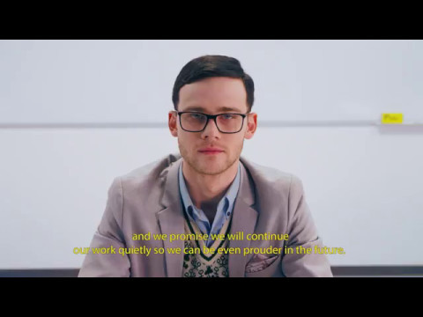
innovation
innovation
tradition
Notes:
Sometimes we ask in Estonia – while joking – what are you eating to be that smart?
There is nothing special in Estonian Cuisine, but may be there is something in our education ...
The way the teachers help their students to reach the goals set in curricula, is entirely up to them. There are around 20 000 teachers working in general education in Estonia (incl early childhood teachers). Are they all innovative enough? Or, let’s ask first – what is innovation in education?

Slide 8
4 key factors
School autonomy
Digi-friendly society
right to make decisions about staff, budget and curriculum
e-curiosity promoted from kindergarten
Teachers
Equity
well educated and committed professionals
socio-economic background does not matter
Notes:
The first – school autonomy – is characteristic for the Sedeish system as well - next slide, Sweden next to Estonia

Slide 9
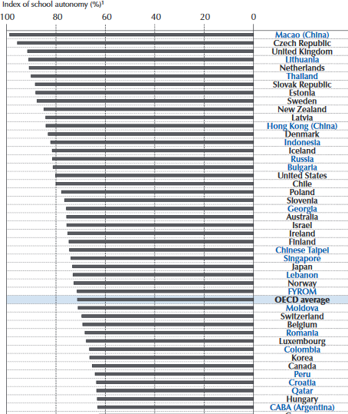

School autonomy
Comendio, M. (2017). Empowering and Enabling Teachers to Improve Equity and Outcomes for All. OECD publishing.

Slide 10
School autonomy
Estonian schools can:
Recruit and hire teachers who fit in their school culture
Plan and use their finances, establish teachers’ salary and motivational systems
Promote teachers’ professional development/ in-service training (schools can use 2% from salary budget for those purposes)
Develop their own curricula, based on the framework of the national curricula, taking into account local needs, community interests, resources
Compile and adopt a school’s development plan with mission, values and goals agreed among all staff members and parents
Carry out integration of subjects and define learning outcomes at each class level

Slide 11
Teachers
Teacher training is provided at university on MA level
94% teachers in comprehensive schools have MA level university education, more than 90% are graduates of teacher training programs
Special support program (induction year) for novice teachers
Regular in-service training, mainly carried out by universities
Duty of the school leader – to plan and create possibilities for teachers’ professional development

Slide 12

Teacher is the key
TALIS (2013):
The average Estonian teacher is an older, experienced woman with an MA degree who often teaches not full time in a small classroom

Slide 13
Talis 2013

Slide 14
Teachers’ professional development
Initial education
Identity building and readiness to improve own practice
Induction year
Conceptualizing own teaching and collaboration with others
Continuing education
Action research and teacher leadership

Slide 15
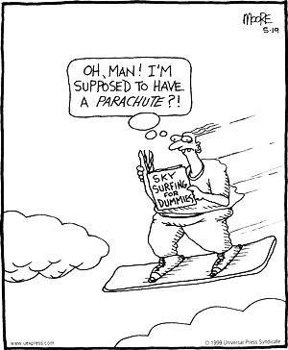
Induction year
Supporting the professional development of a novice teachers;
Supporting sozialisation into school as an organization;
To increase the cooperation between teachers and form professional learning communities;
To have a brigde between initial education and continuing professional development.

Slide 16
Equity
Almost all kids are participating in pre-school education, participation rate about 95% (highest rate among the OECD countries)
Low socio-economic background and risk group families are exempted from pre-school education fees
To ensure equal access to education and equity in everyday school-life, free textbooks, healthcare services, transportation to school and free lunch during the schoolday are provided to all school children
Free support systems to overcome study challenges and for considering SEN – speech therapist, services of psychologists, social workers etc are provided

Slide 17
Digi-friendy society
Estonian pupils are the most active users of e-school and school web site
Socio-economic background has no influence on Estonian pupils’ access to computers and internet at home (SITES 2009)
Estonian schools are the most active in online collaborative projects (Globe, eTwinning)
Widespread use of online gradebook - hygiene level technology use (PISA 2012)
Active online communities of teachers
Flexible policies on BYOD

Slide 18
Every country has its own PISA-challenges
☺ | ☹
Share of satisfactory students Table science performance Positive trend in reading Positive trend in math Share of low achievers Low level anxiety Share of top performers in science | Gender gap in reading skills Knowledge and skills gap between students from Estonian shools and Russian schools Share of top performers in reading Share of top performers in math Students’ low sense of belonging Bullying

Slide 19
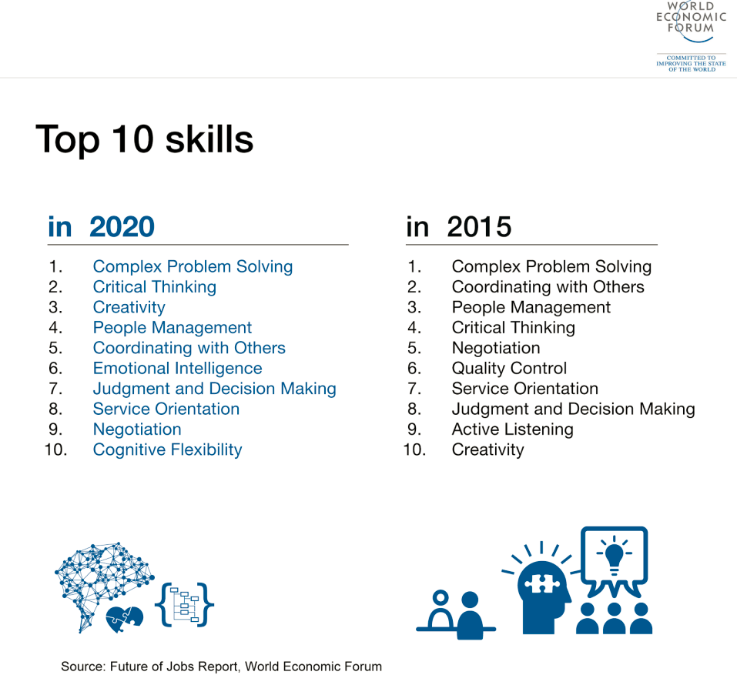
The Future of Jobs. Employment, Skills and Workforce Strategy for the Fourth Industrial Revolution. World Economic Forum, 2016
Top 10 skills

Slide 20
Future of labor market
Impossible to predict and rapidly changing
Half of today’s jobs will not exist by 2025
65% of enrollees in primary schools will get jobs that do not currently exist
75% of jobs will be STEM (Science, Technology, Engineering, Mathematics) related.

Slide 21
The study “Estonian Labour Market Today and Tomorrow”, 2017
MAIN QUESTIONS:
which occupations and skills the Estonian labour market needs till the year 2024
how the education and training supply meets these needs
METHODOLOGY:
use a combination of qualitative and quantitative research methods
analyse professional qualifications across all levels of education
both statistical data and information collected from personal interviews with sectoral experts and from group discussions are used
five economic sectors are examined each year (altogether 24 sectors)
each sector is analysed every six years on average
http://oska.kutsekoda.ee/en/future-labour-market-trends/estonian-labour-market-today-tomorrow/

Slide 22
Main findings (1): The biggest changes take place in the expected skills, not in the professions
In all professions, the importance of ICT skills, that is, the ability to deploy and develop technology, is increasing
Good professional skills in combination with advanced generic skills, e.g., language, analysing, problem solving and teamwork skills, is highly valued
Personality-related attitudes like openness to innovation, learning ability as well as flexibility are also important

Slide 23
Main findings (2): Preconditions for employment are the graduates with necessary skills
In education, in order to meet the needs of the labor market, it is necessary :
to use more active learning methods
to teach field-specific ICT skills
to improve organization of internships and introduce the modern business environment both to lecturers and students
provide more flexible learning opportunities for employees

Slide 24

Estonian
Lifelong Learning
Strategy 2020
Putting words into action.

Slide 25
Vision 2020
Learning is a lifestyle.
Let’s notice development opportunities and let’s look for clever solutions.
Responsibility
People understand that learning and self-development are their own choice and responsibility.
Needs
Studies are based on the learner’s interests and capabilities, support his development and meet actual labour market needs.
Opportunities
The lifelong learning system offers good- quality, modern & flexible study opportunities that account for a learner’s special needs

Slide 26
The 5 main goals of Lifelong Learning Strategy 2020
A change in the approach to learning.
Competent and motivated teachers and school leadership.
The compatibility of lifelong learning with the real needs of the job market.
A digital turn in lifelong learning
Equal opportunities for lifelong learning and increased participation.

Slide 27
The three directions of educational change

Slide 28
Constructivist approach
Learning is individual, active and takes place in a context.
1
Notes:
constructivist approach, which is based on the principles that learning is individual, active and activity-based, and takes place in a specific context.
This means that the existing knowledge and skills base of the learners should be evaluated on a broader scale and the developments in learning psychology shall be taken into account; Good subject knowledge and skills as well as vocational and professional skills remain important for coping in life and continuing one’s education. Learning skills create opportunities for constant self-improvement, the acquirement of new skills and knowledge in and outside schools as well as independently later in life.

Slide 29
Collaborative learning
Learning to work together towards a shared goal.
2
Notes:
collaborative learning, which means working towards a common goal. Maximising learning by every participant as well as other members of the group is important here. Collaborative learning creates more cohesion at schools, in communities and in society as a whole. Collaborative skills are important in learning as well as in future work. The skills of managing and motivating people and negotiation skills can also be seen as components of collaborative skills. Collaborative skills are based on emotional and social intelligence, i.e. skills of understanding and influencing the behaviour, thinking and emotions of oneself and others in different situations.

Slide 30
Autonomy
Moving towards the increased freedom of action of the school, teachers and learners.
3
Notes:
autonomy, which means moving towards the increased decision-making rights and freedom of action of the school, teachers and learners.
Studies indicate that a more autonomous operational model supports the positive climate of a school, inner motivation of participants and is related to better learning outcomes, subjective well-being and self-regulation. A self-regulated and independent member of society is able and ready to define one’s needs and goals, choose well-considered ways for achieving these and evaluation of results, and be responsible for one’s actions and choices.

Slide 31

But all that is nothing new.

Slide 32
Universities and schools as partners in collaborative learning.
Establishing educational innovation centres.

Slide 33
Results so far
Overview of the reality of schools and their needs
A trusting working relationship between schools and universities
A growing common understanding about the future of education an how does learning happen

Slide 34
From quality of performance to quality of learning?
Despite excellent PISA results we are struggling with
students’ subjective well-being in schools
student engagement and burn-out
teacher’s subjective well-being

Slide 35
What are the main characteristics of the „quality of learning“?
https://menti.com
Code: 917325

Slide 36
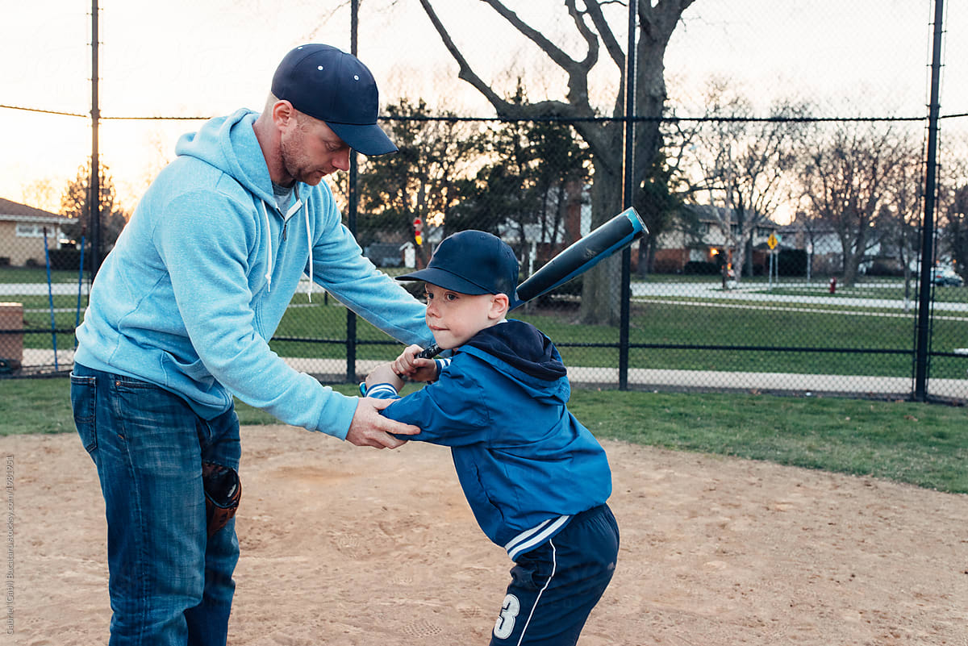

What I have done
What I will do

Slide 37


Study for the test
Study to learn

Slide 38

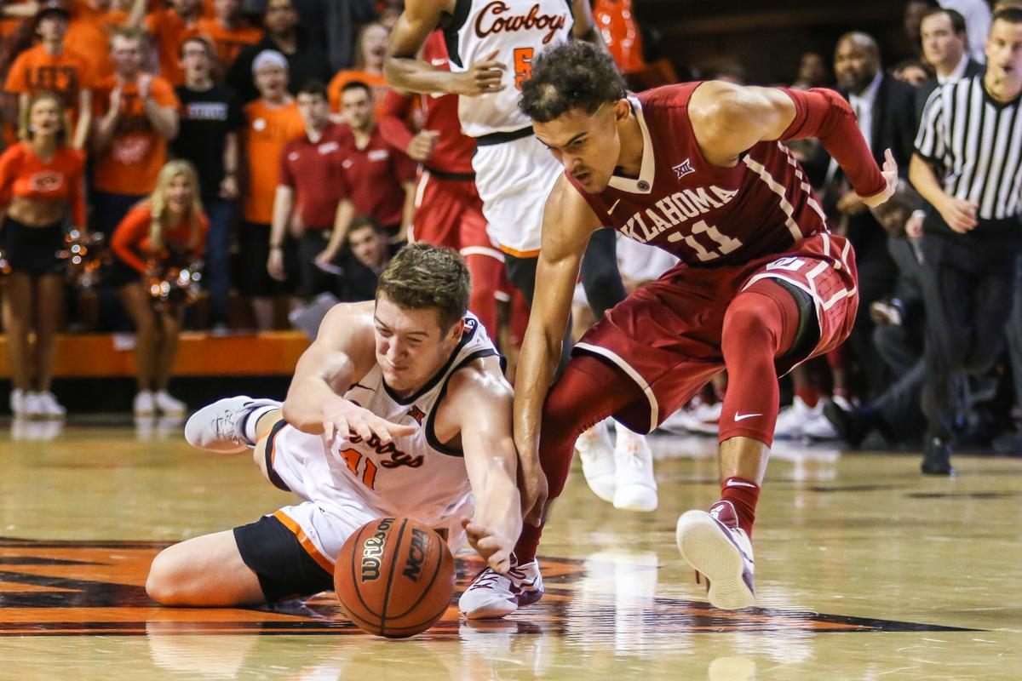
Praise effort
Praise talent/ability

Slide 39


Protect from failure
Failure is a friend

Slide 40
Success of others
Criticism
Effort
Sees inspiration and learning opportunities in the success of others
Dealing with setbacks
Learns from criticism and feedback
Sees that growth and learning require effort
Challenges
Manages mistakes and setbacks efficiently
Loves challenges
Avoids challenges and complicated tasks
Gives up easily
Sees effort as a sign of incompetence
Ignores critical feedback
Feels threatened by the success of others

Slide 41
What about you?
Please go to menti.com
code 917325
and rate your mindset on the following scale:
Purely fixed mindset
Purely growth mindset

Slide 42
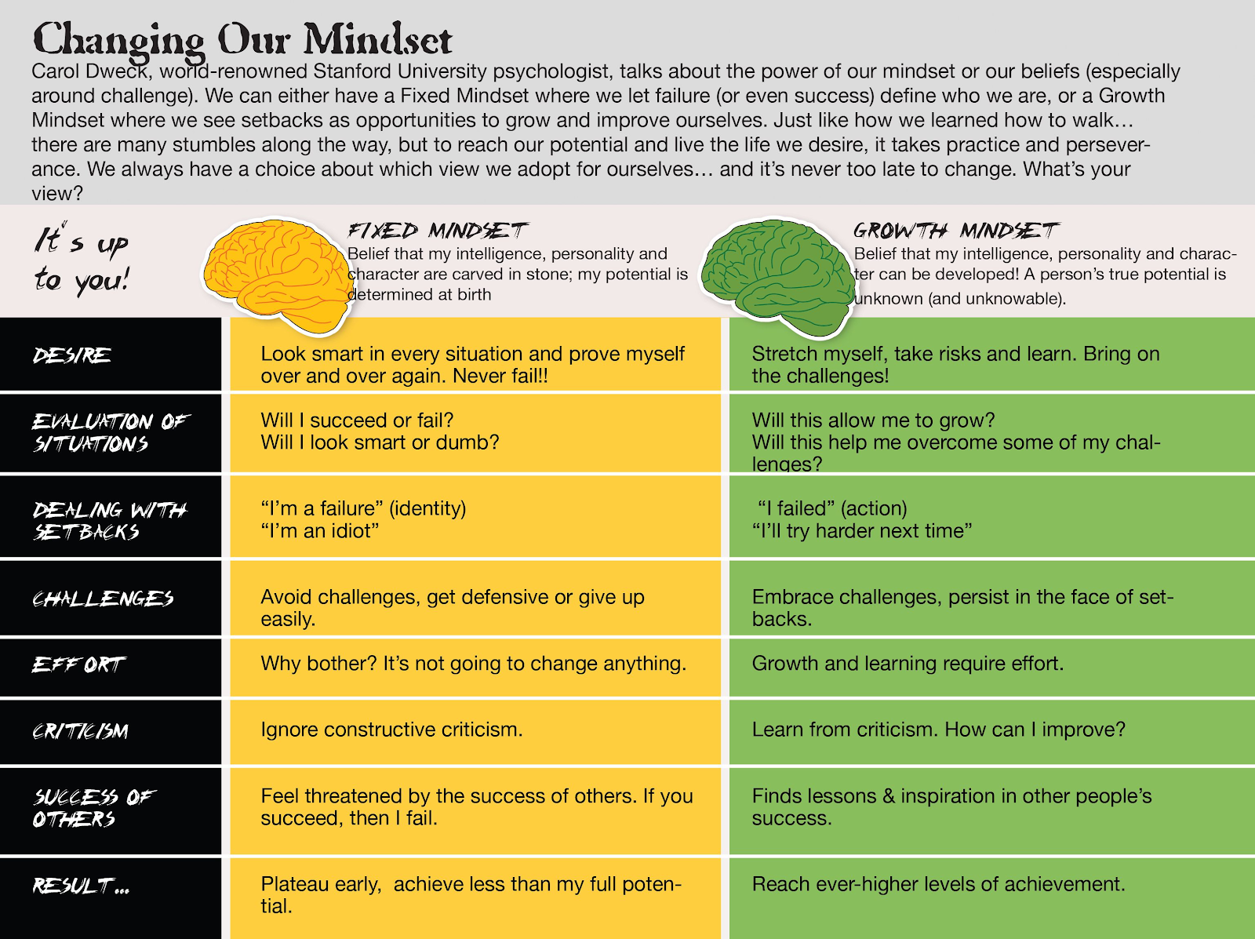
What can we do about
It?

Slide 43
Learning in the context
of educational innovation
1
LEARNING
Are we accounting for how the brain works and how learning happens?
2
MINDSET
What kind of messages are we sending about improvement?
3
MOTIVATION
Are students’ basic psychological needs satisfied in this environment?

Slide 44
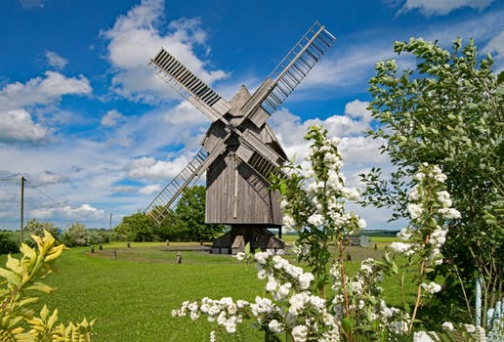
Waiting for the wind

Slide 45

Catching the wind

Slide 46

Good winds to all of us!

